Slide 1

Introduction To Object-Oriented Programming
Chapter 3 – Introducing Lists

Slide 2
What Is a List?
A list is a collection of items in a particular order. You can make a list that includes the letters of the alphabet, the digits from 0 to 9, or the names of all the people in your family. You can put anything you want into a list, and the items in your list don’t have to be related in any particular way.
In Python, square brackets ([]) indicate a list, and individual elements in the list are separated by commas
If you ask Python to print a list, Python returns its representation of the list, including the square brackets

Slide 3
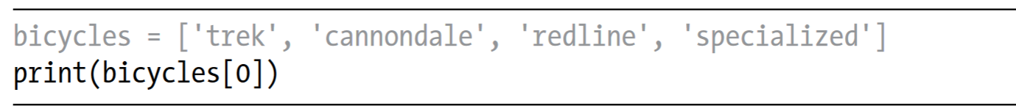
Accessing Elements in a List
Lists are ordered collections, so you can access any element in a list by telling Python the position, or index, of the item desired. To access an element in a list, write the name of the list followed by the index of the item enclosed in square brackets.

Slide 4
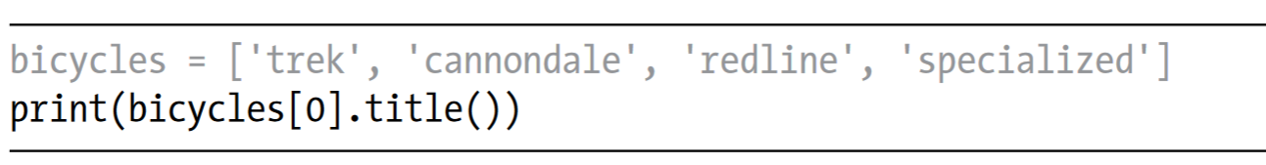
Accessing Elements in a List
You can also use the string methods on any element in this list. For example, you can format the element 'trek' to look more presentable by using the title() method:

Slide 5
Index Positions Start at 0, Not 1
Python considers the first item in a list to be at position 0, not position 1. This is true of most programming languages, and the reason has to do with how the list operations are implemented at a lower level.
The second item in a list has an index of 1. Using this counting system, you can get any element you want from a list by subtracting one from its position in the list. For instance, to access the fourth item in a list, you request the item at index 3

Slide 6
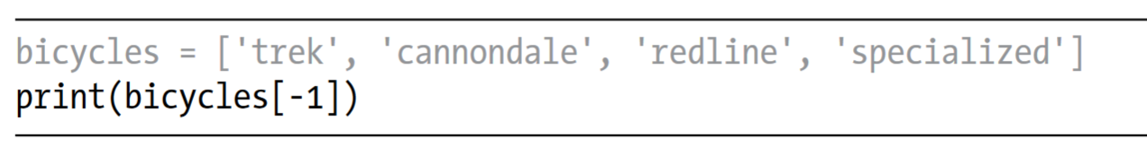
Index Positions Start at 0, Not 1
Python has a special syntax for accessing the last element in a list. If you ask for the item at index -1, Python always returns the last item in the list
This syntax is quite useful, because you’ll often want to access the last items in a list without knowing exactly how long the list is. This convention extends to other negative index values as well. The index -2 returns the second item from the end of the list, the index -3 returns the third item from the end, and so forth.

Slide 7
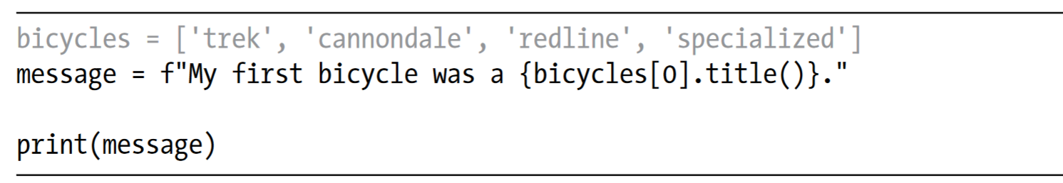
Using Individual Values from a List
You can use individual values from a list just as you would any other variable. For example, you can use f-strings to create a message based on a value from a list.

Slide 8
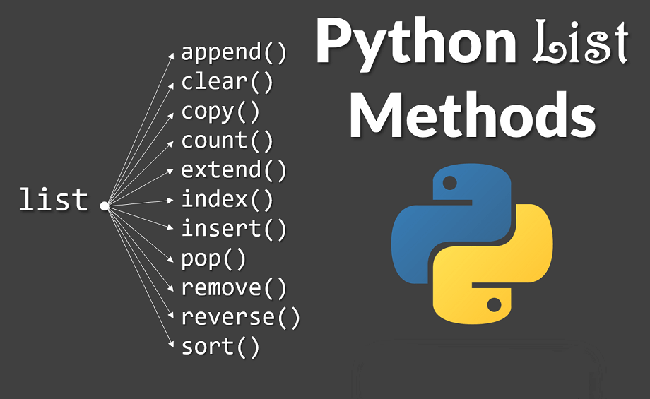
Modifying, Adding, and Removing Elements
Most lists you create will be dynamic, meaning you’ll build a list and then add and remove elements from it as your program runs its course.

Slide 9
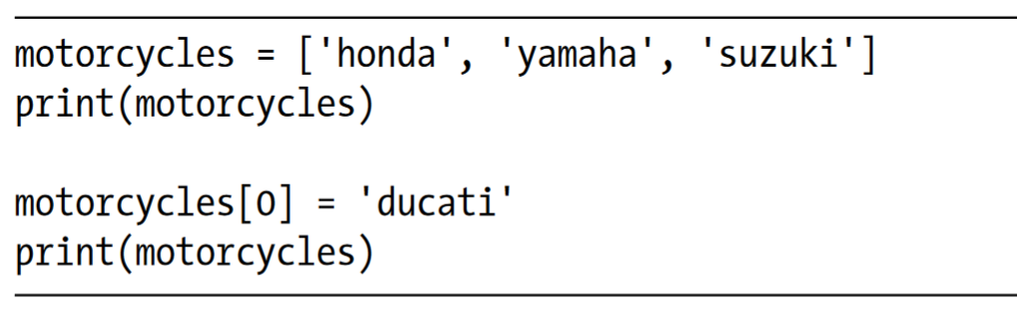
Modifying Elements in a List
The syntax for modifying an element is similar to the syntax for accessing an element in a list. To change an element, use the name of the list followed by the index of the element you want to change, and then provide the new value you want that item to have

Slide 10
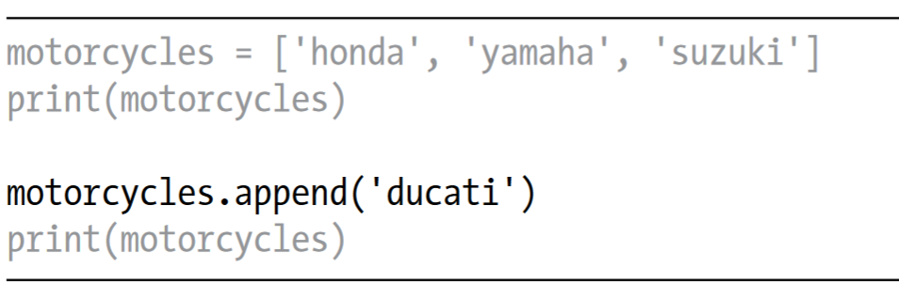
Adding Elements to the End of a List
The simplest way to add a new element to a list is to append the item to the list. When you append an item to a list, the new element is added to the end of the list.

Slide 11
Adding Elements to the End of a List
The simplest way to add a new element to a list is to append the item to the list. When you append an item to a list, the new element is added to the end of the list.

Slide 12
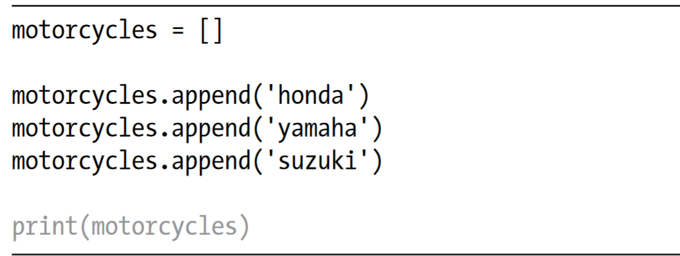
Adding Elements to the End of a List
The append() method makes it easy to build lists dynamically. For example, you can start with an empty list and then add items to the list using a series of append() calls.

Slide 13
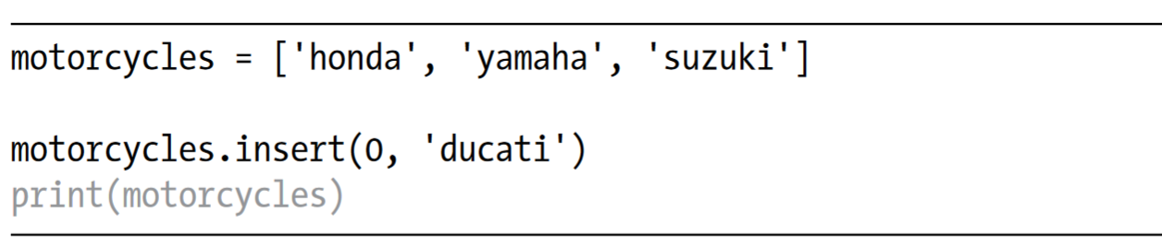
Inserting Elements into a List
You can add a new element at any position in your list by using the insert() method. You do this by specifying the index of the new element and the value of the new item

Slide 14
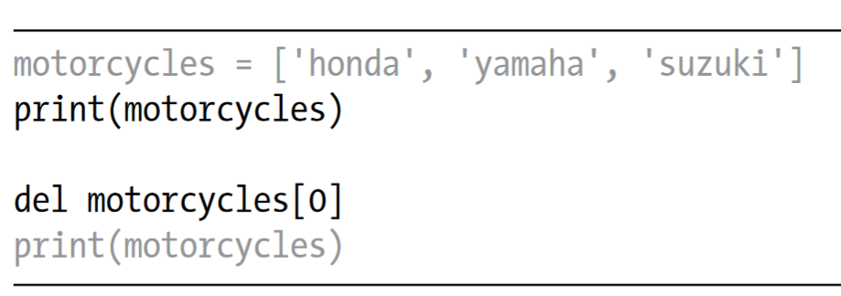
Removing Elements from a List by using del
If you know the position of the item you want to remove from a list, you can use the del statement

Slide 15
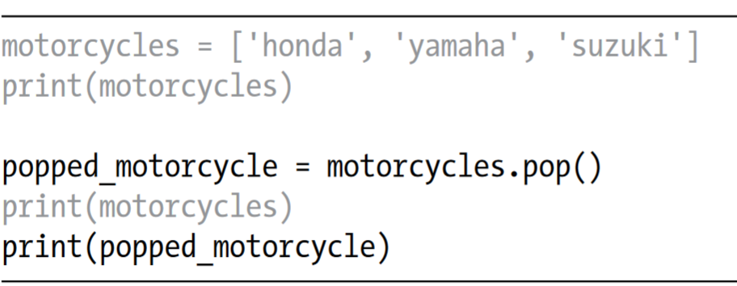
Removing an Item Using the pop() Method
Sometimes you’ll want to use the value of an item after you remove it from a list. The pop() method removes the last item in a list, but it lets you work with that item after removing it.
The term pop comes from thinking of a list as a stack of items and popping one item off the top of the stack. In this analogy, the top of a stack corresponds to the end of a list.

Slide 16
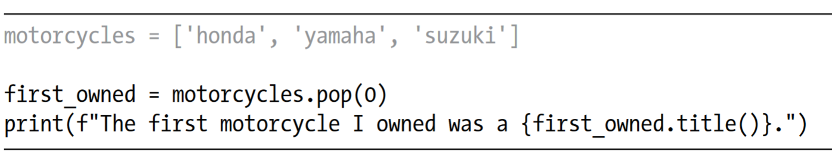
Popping Items from Any Position in a List
You can use pop() to remove an item from any position in a list by including the index of the item you want to remove in parentheses

Slide 17
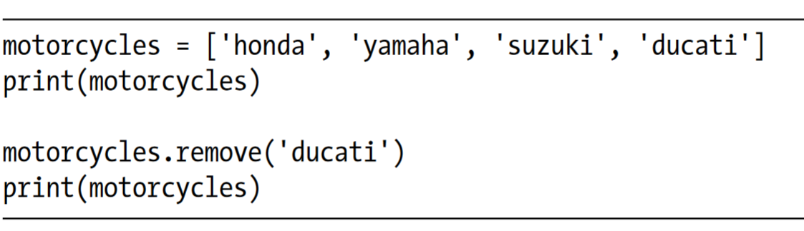
Removing an Item by Value
Sometimes you won’t know the position of the value you want to remove from a list. If you only know the value of the item you want to remove, you can use the remove() method.

Slide 18
Organizing a List
Often, your lists will be created in an unpredictable order, because you can’t always control the order in which your users provide their data.
Although this is unavoidable in most circumstances, you’ll frequently want to present your information in a particular order.
Sometimes you’ll want to preserve the original order of your list, and other times you’ll want to change the original order.
Python provides a number of different ways to organize your lists, depending on the situation.

Slide 19
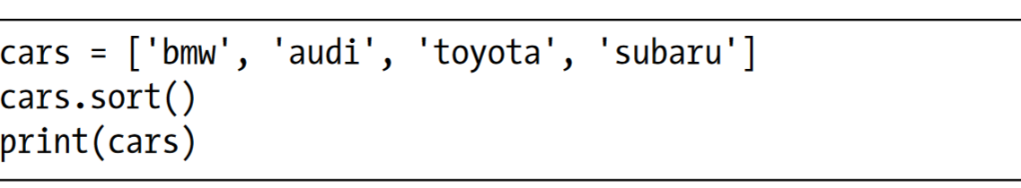
Sorting a List Permanently with the sort() Method
Python’s sort() method makes it relatively easy to sort a list.
The sort() method changes the order of the list permanently.
You can also sort this list in reverse-alphabetical order by passing the argument reverse=True to the sort() method.

Slide 20
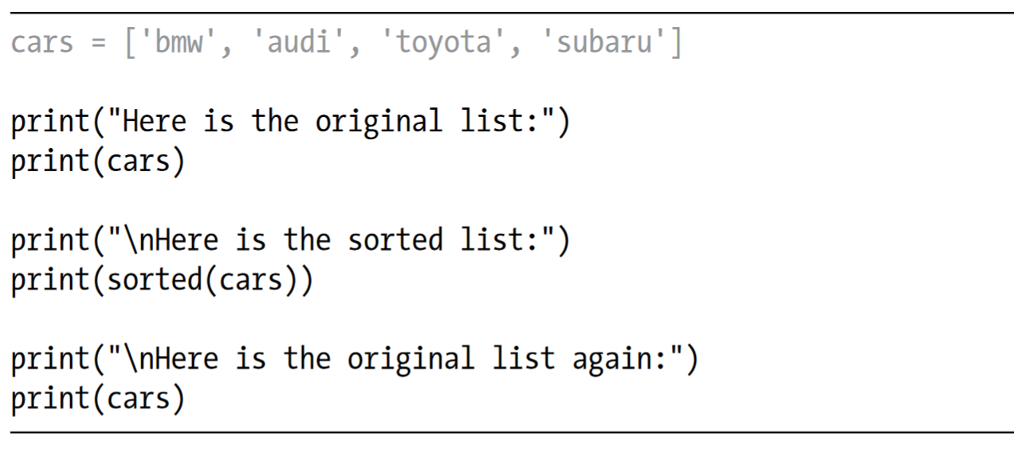
Sorting a List Temporarily with the sorted() Function
To maintain the original order of a list but present it in a sorted order, you can use the sorted() function. The sorted() function lets you display your list in a particular order but doesn’t affect the actual order of the list.

Slide 21
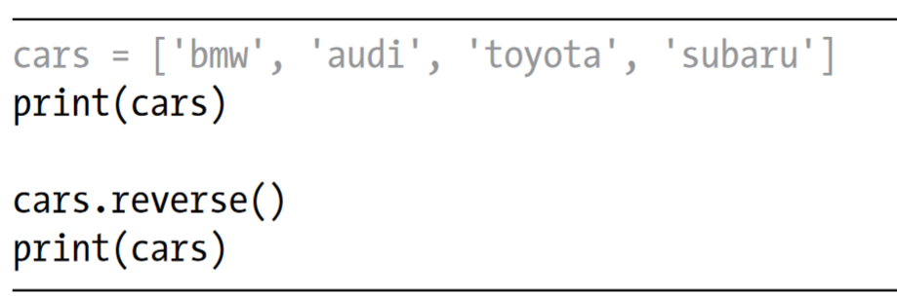
Printing a List in Reverse Order
To reverse the original order of a list, you can use the reverse() method.

Slide 22
Printing a List in Reverse Order
Notice that reverse() doesn’t sort backward alphabetically; it simply reverses the order of the list. The reverse() method changes the order of a list permanently, but you can revert to the original order anytime by applying reverse() to the same list a second time.

Slide 23
Finding the Length of a List
You can quickly find the length of a list by using the len() function.
You’ll find len() useful when you need to identify the number of aliens that still need to be shot down in a game, determine the amount of data you have to manage in a visualization, or figure out the number of registered users on a website, among other tasks

Slide 24
Avoiding Index Errors When Working with Lists
There’s one type of error that’s common to see when you’re working with lists for the first time.
An index error means Python can’t find an item at the index you requested.
If an index error occurs in your program, try adjusting the index you’re asking for by one. Then run the program again to see if the results are correct.

Slide 25
Summary of Chapter 3
In this chapter, you learned what lists are and how to work with the individual items in a list.
You learned how to define a list and how to add and remove elements.
You learned how to sort lists permanently and temporarily for display purposes.
You also learned how to find the length of a list and how to avoid index errors when you’re working with lists.

